Slide 1
ROLE OF INFORMATION SYSTEMS IN THE MODERN ORGANIZATION
      Information technology (IT)
      electronic storage, retrieval, and manipulation of data;
      its conversion into human-usable form (i.e., information); and
      its transmission from one point to another.

Slide 2
Definitions
Hardware
any physical item that comprises a computer system.
monitor, keyboard, mouse, microchips, or disk drives.
anything in information technology that can be touched.

Slide 3
Definitions
Software
combination of computer programs
instructions to the computer hardware
may serve as input to other pieces of software.
Software is intangible and is anything in the computer system that is not hardware.
Examples are Microsoft Word, CCH's TaxWise, or IDEA Data Analysis Software

Slide 4
Definitions
  Network
  collection of hardware devices
  interconnected so they can communicate
  allows different hardware to share software and communicate data.
    The Internet is an example of a network

Slide 5
Definitions
  Data
  raw facts stored in hardware.
      may be financial sales data or could be calculations provided by a software program.
Information
  Data formatted in a way that supports a decision maker
  Knowledge
  Decision maker must have this for data to be used as information

Slide 6
Business Information Systems
Combination of hardware, software, data, people, and procedures employed to pursue an organizational objective
    First generation served the finance and accounting functions—Transaction Processing!
      Financial Reporting

Slide 7
Business Information Systems
Designed to support:
  Business processes—create purchase orders, sales orders, receiving reports
  Decision making—sales reports, vendor performance, customer profitability.
  Planning-budgets

Slide 8
GENERIC MODEL OF A SYSTEM
INPUTS
PROCESS
OUTPUTS
STORAGE

Slide 9
Electronic Communication
A fact of life!
The cutting (bleeding) edge right now is the cloud.
  Software as a Service (SaaS)—Application system (Office 365)
  Platform as a Service (PaaS)—Data Storage (DropBox) & System Management
    Open source operating systems (Lunix)
  Infrastructure as a Service (IaaS)—Hardware virtualization
Changing cost structures from Cap Ex to Op Ex

Slide 10
Transaction Processing
Transaction-a single discrete event captured in an IS.
Batch processing—Transaction data are captured in batches (a day’s sale data is entered) and then processed sometime in the future.
Online-real-time processing—Transaction data are captured and processed immediately.
Online batch processing—Transaction data are captured in real time, but processed later.

Slide 11
Infrastructure
Centralized→Decentralized→???
  How does cloud computing fit in?

Slide 12
Application Processing Phases
Data Capture
  Batch
  Online
Processing
Data Files (Batch Processing)
  Transaction files—contain transaction data!
    Sales journal
    Purchases journal
  Master files—contain records that are update
    Subsidiary ledgers
    General ledgers
TF
CPU
UMF
MF

Slide 13
Application Processing Phases
REA—Relationships, Entities, Agents
  Bill McCarthy from Michigan State came up with this model.
  Used to model and build relational databases
  Eliminates need for double entry accounting
  Most computerized AISs use relational databases
  Accountants still want to see reports that look like double entry accounting, so all AIS will generate output that LOOK like a journal.

Slide 14
Application Processing Phases
Reporting—output.
  Periodic—Financial statements
  On-demand—you did a number of these in QB!
  Exception—variances that exceed parameters.
  Audit trail—transaction logs

Slide 15
Systems Supporting Routine Processes—structured problems
Management Information Systems
  Old School
  Stove-piped systems
  Contain modules for:
    Accounting
    Finance
    Production Operations Management
    Logistics
    Marketing
    HR
  Most MISs have been replaced by ERPs.

Slide 16
Systems Supporting Routine Processes
Accounting Information Systems
  Can be a stand-alone product (QB), or
  A module in an MIS or ERP
  Main focus is on financial reporting in an SEC environment
  Lip-service is sometimes paid to Managerial/Cost Accounting

Slide 17
Systems Supporting Routine Processes
Enterprise Resource Planning Systems (ERPs)
  Evolved MIS.
  Main difference is that they break down the stove pipes.
    Allow communication between modules
    Allow communication up and down the supply chain

Slide 18
Systems Supporting Decision Making—semi-structured and unstructured problems
Data Warehouse
  Contain raw transaction-level data
  Started building these in the 90s
    Dumping ground for Transaction Processing Systems
    Idea was “let’s keep everything cuz someday we might figure out what to do with it.”
    That day has come
      online analytical processing (OLAP) and
      Data Mining—correlation analysis
        Looking for unexpected relationships

Slide 19
Systems Supporting Decision Making
Decision Support Systems (DSS)
  Support semi-structured problems.
    System can help with the heavy lifting.
      Sort and rank on specified criteria
      Human then makes a choice
      Spread sheets can do this!

Slide 20
Systems Supporting Decision Making
Business Intelligence (BI)
  New area of decision support
  Desktop tool for slicing and dicing data
  Newer versions of MS Excel have “dashboard” tools.
    PowerPivot
    Powerview

Slide 21
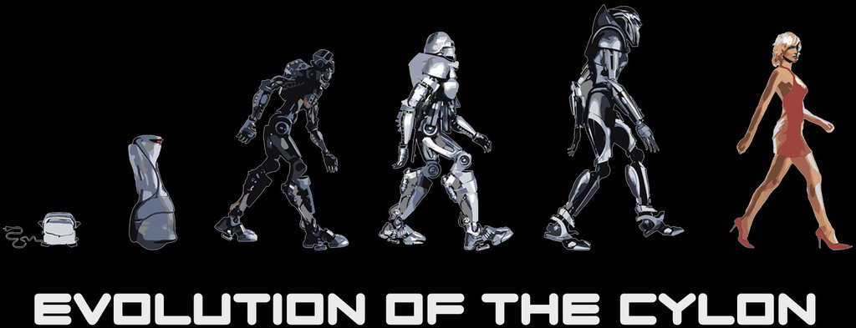
Systems Supporting Decision Making
Artificial Intelligence (AI)
  The Cylons are here!
  Perceive, Reason, Understand
  Most successful in medical applications
  Turing Test--http://www.princetonai.com/bot/

